Slide 1
Ora2pg
Demo, difficulties, architecture and more

Slide 2
Demo (DB)

Slide 3
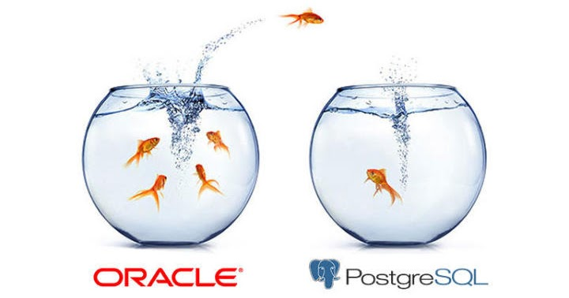
Logic is simple:
Oracle: 0.1 billion records, 50+ GB data
Need to copy data from oracle to Postgres
Keep monitoring db changes & perform CRUD operations

Slide 4
Components and architecture

Slide 5
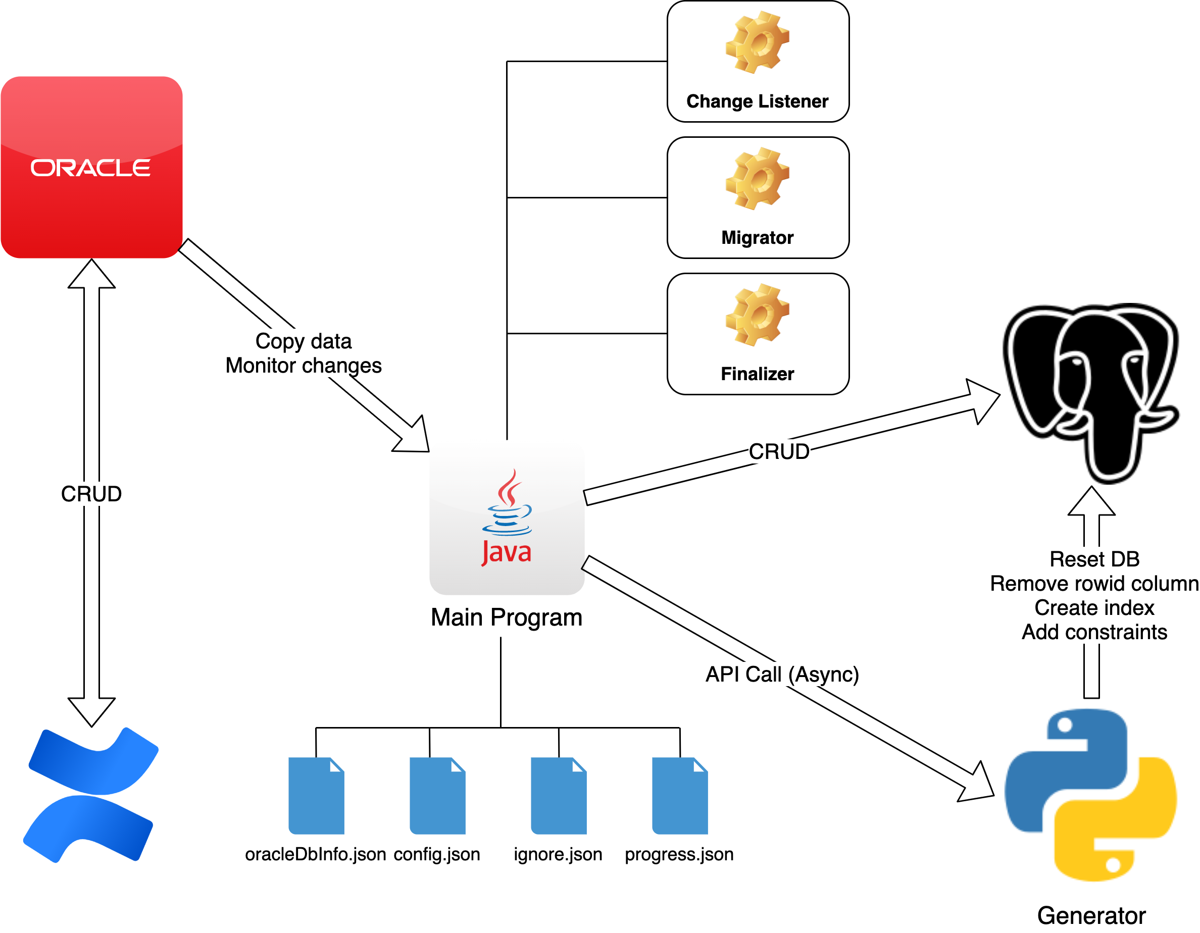

Slide 6
<Main migration program>
Repo:
How to run: ./dev copy | finalize | clean

Slide 7
<Generator>
Repo:
URL:
How to run (API call):
  /loadschema
  /droprowid
  /index
  /constraint

Slide 8
Difficulties

Slide 9
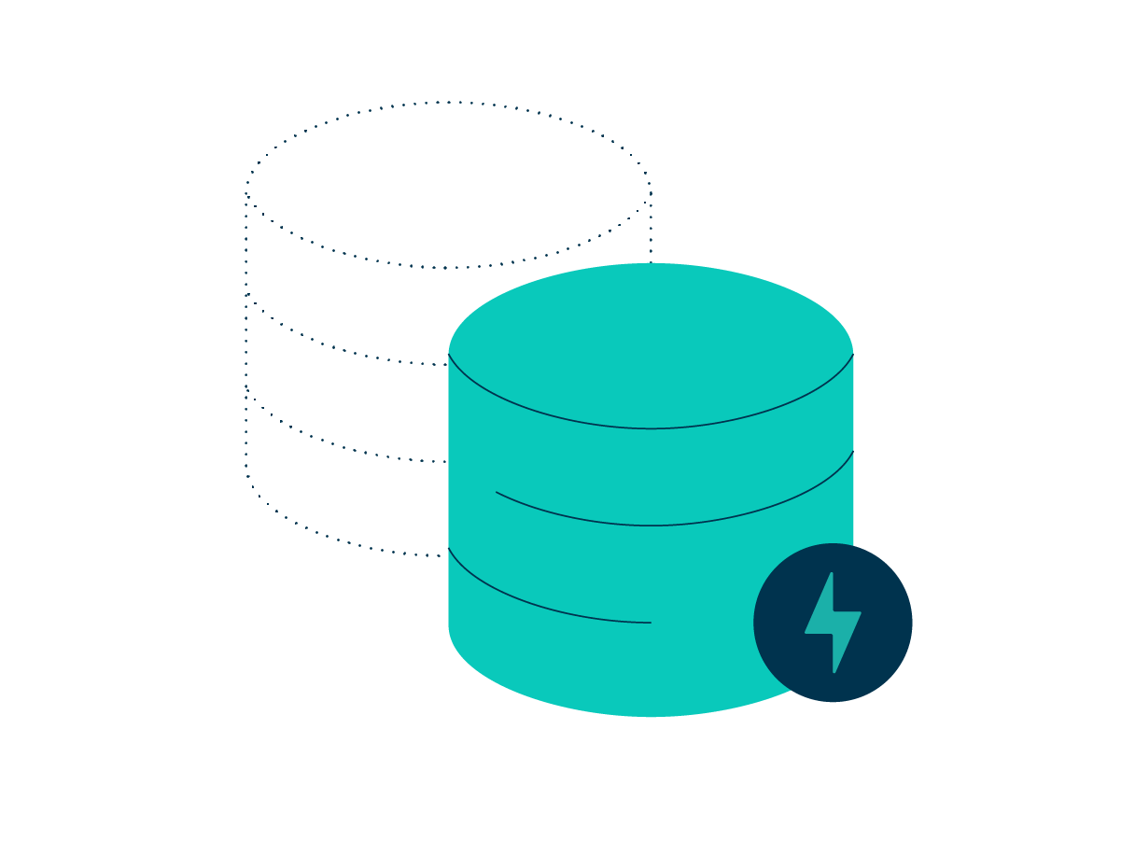
How to create a good sql dump file?
We fresh installed a new confluence, installed all plugins we have in prd confluence and then generate the sql file
URL:

Slide 10
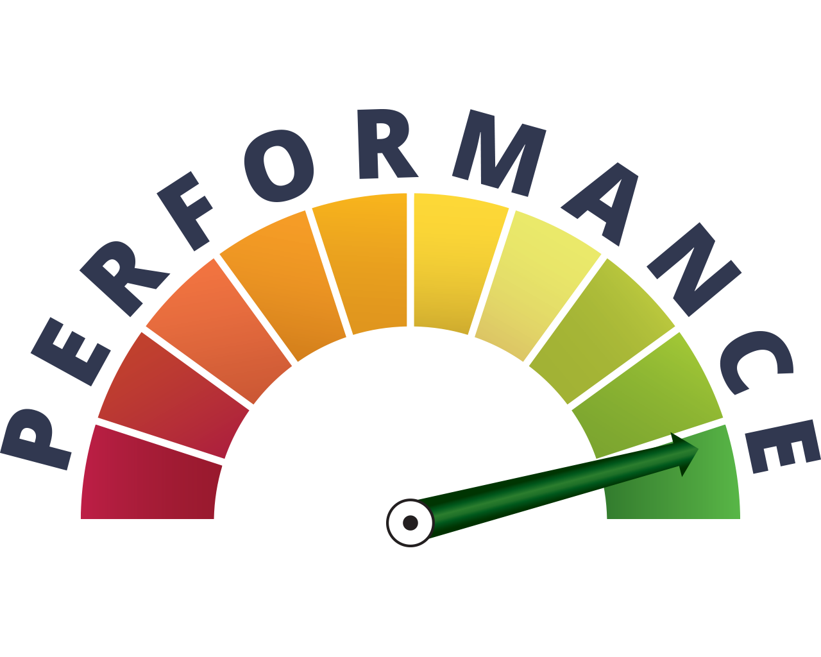
Performance: 1+ weeks -> 3 hours
Connection pooling
Threads
Rowid based pagination

Slide 11
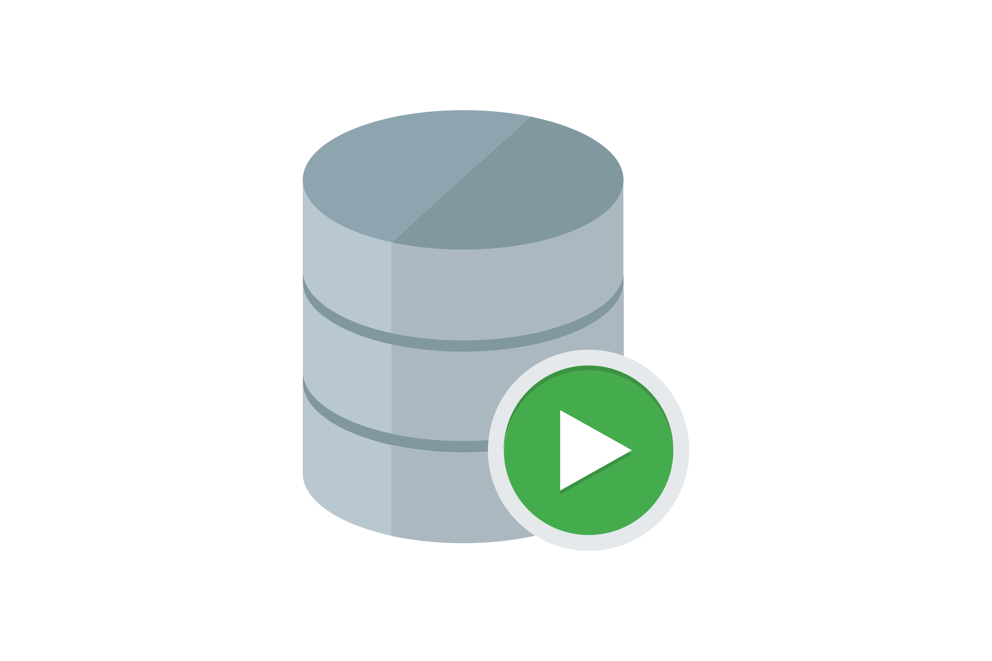
DB/SQL compatibility
Missing tables, columns: ignore.json
Name mismatch: query all available tables, build the mapping cache
Data types conversion

Slide 12
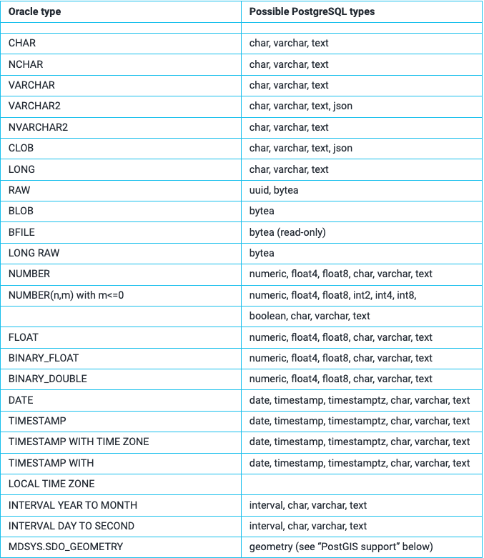

Slide 13
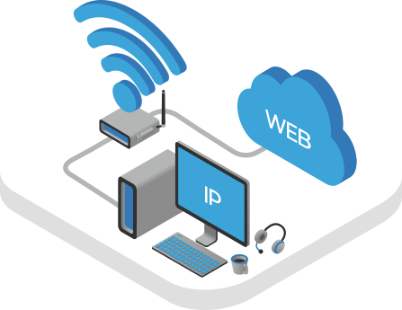
What is my external IP?
AppRunner URL:

Slide 14

Haproxy/Utopia timeout: Sync -> Async
Option 1: update haproxy timeout limit

Slide 15


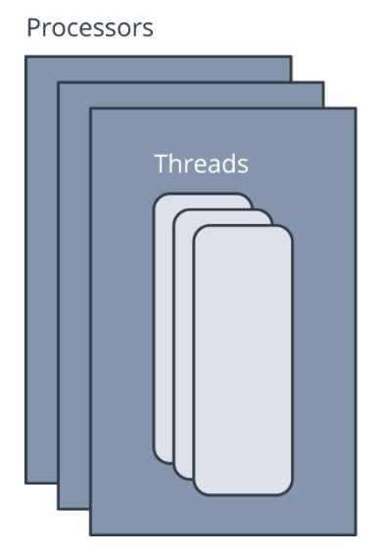
Haproxy/Utopia timeout: Sync -> Async
Option 2: API sync -> async, Flask background task
  Use celery: too heavy, require redis/rabbitmq backend
  Threads/Future, unique job id

Slide 16
Thanks

